Slide 1
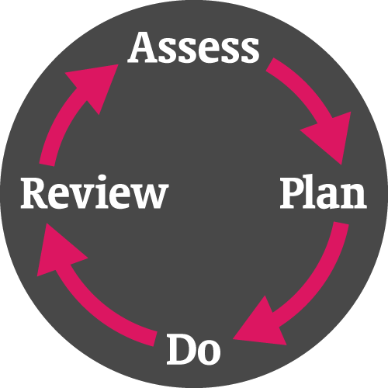
Levels of Support
At Marshbrook, we meet the needs of all pupils through excellent teaching and learning, providing a fully scaffolded curriculum and personalising the learning experience.
QUALITY FIRST TEACHING
Universal Support
This is the delivery of high quality, inclusive teaching taking into account the needs of all learners.
Universal Plus/Targeted Intervention
This is for those pupils who may require some additional support in order to maintain the expected levels of progress. This support can take place in lessons or in small groups of pupils who have similar needs.
Highly Personalised Support/Intervention
This is highly individualised support for a minority of pupils who require highly-tailored interventions in order to achieve their potential. This usually means an EHCP.
4 Areas of Special Education Need (SEN)
Communication and interaction
Cognition and learning
Social, emotional and mental health
Sensory and/or physical needs
Concerns over a pupil’s progress or needs can be raise by:
The pupil
Class teacher
Parents or carers
Support staff
Medical professionals
Social Care teams
The Graduated Response
(Assess, Plan, Do, Review)
At Marshbrook, we use this system to: assess pupil’s needs; identify strengths, barriers and strategies; write personalised targets; plan for those outcomes; evaluate them in a regular cycle.
SEN Support
For those pupils who, despite targeted support, are still making little or no progress, Marshbrook may invite professionals from outside agencies to come into school and offer advice from their field of expertise. This would be done only with parental permission and the outcomes would also be shared with parents.
Pastoral Support
Marshbrook has a fully supportive pastoral system of care, available for all pupils. Staff follow clear procedures in cases of bullying or with behavioural issues. The SEND and pastoral systems work together to benefit all pupils.
For further detailed information, please see the policies available on the school website.
EHC Plans
Some pupils’ need for highly tailored, long term support may require applying for an Education, Health and Care Plan through the Local Authority.

Slide 2

At Marshbrook we want to:
Maximise pupil performance
Deliver a fully scaffolded curriculum
Use a range of teaching strategies and methodologies
Provided all pupils equal access to the curriculum
Provided all pupils equal access to extra curricular activities
Support pupils in a variety of ways to suit individual needs and requirements
Prepare pupils to become employable and valuable citizens
Our Team
SENDCo
Headteacher
Class teachers
Teaching Assistants
Learning Support Assistants
For further information please see the school webpage which has our policy, Staffordshire’s Local Offer and a full school SEN Information Report.
Information for Parents and Carers
The SEN Code of Practice
Inclusion Team Expertise
We have undertaken training in supporting students with:
ASC
Dyslexia
ADHD
A range of mental health needs
Visual & Hearing impairments
Speech & Language needs
Agencies We Work With
Speech and Language Therapists
Occupational Therapists
Educational Psychologists
Hearing Impairment Team
Visual Impairment Team
Autism Inclusion Team
CAMHS
Family Support & Social Care
Parental and Pupil Involvement
We work together with you through:
Termly class teacher meetings
Review of APDR three times per year
APDR Pupil voice
APDR Parent contribution
Academic reports from class teachers
Annual reviews for students with an Education, Health and Care Plan
Regular contact with class teachers
For any queries, comments or questions, please contact the school office or the SENDCo.

